Slide 1
Measuring Pedagogies from Secondary School to University and Implications for Mathematics education (in UK and abroad)
Maria Pampaka & Julian Williams
The University of Manchester
BSRLM March 3rd 2012
Manchester

Slide 2
Outline
Introduction: STEM, reform and pedagogy
Background to the projects
(college) Teachers’ reported pedagogical practices (and effect on models of students’ dispositions)
Students’ reported perception of pre-university pedagogical experience
Comparison of measures from UK and Norway
Some more comparisons and associations
(Pedagogy at Secondary school)
Concluding remarks

Slide 3
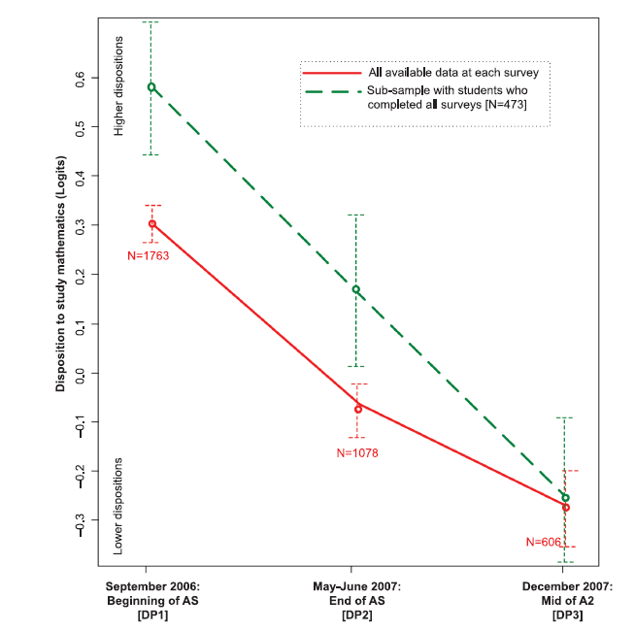
Introduction: The STEM ‘issue’
STEM: Science Technology, Engineering and Mathematics
Participation remains problematic
Students dispositions are declining

Slide 4
Introduction: Reform and pedagogy
Worldwide ‘reform agenda’ of mathematics teaching: emphasis on problem-solving, creativity, and discussion
➔ to improve both understanding and dispositions towards the subject (NCTM, 2000).
BUT, many studies (e.g. TIMSS), have shown how attitudes to mathematics and science are in decline, and that some part of this decline is associated with efforts aimed at increasing standards
Focus on standards is closely associated with traditional teaching, and the marginalisation of reform approaches
the drive to raise standards can be counterproductive for dispositions, especially when it has the effect of narrowing teaching practices. ➔ gap in evidence

Slide 5
Towards a conceptual framework for pedagogic practice
Research on learning environments
Classroom Practices: teacher centred Vs learner-centred
Widely accepted that effective maths teaching should be connectionist, in two ways:
  connecting teaching to students’ mathematical understandings, and productions
  connecting teaching and learning across mathematics’ topics, and between mathematics and other (e.g., scientific) knowledge.
Missing from the debate: informed analysis of teachers’ pedagogy at this level and the impact that this has on student outcomes in terms not only of attainment in, but also developing dispositions towards, mathematics and mathematically demanding subjects.
We try to address this under-researched association

Slide 6
Our focus
Development of the measure of teacher self-reported pre-university pedagogy and its association with students’ learning outcomes
The ‘conversion’ of this pedagogy instrument into two measures of students’ perceived pedagogical experience before and during their first year at university in UK and in Norway (cross-national comparisons)
[The extension/development of these instruments backwards to capture secondary students’ progression into secondary schools (Year 7 to 11)]

Slide 7
The Projects
ESRC funded projects on transition to mathematically demanding subjects in UK Higher Education (HE): TransMaths
  TLRP: “Keeping open the door to mathematically demanding F&HE programmes” (2006 – 2008)
  TransMaths: “Mathematics learning, identity and educational practice: the transition into Higher Education” (2008-2010)
  Lead PI: Prof Julian Williams
An extension of this work in Norway: TransMaths-Norway
  Lead PI: Prof Birgit Pepin
Ongoing ESRC funded study of teaching and learning secondary mathematics in UK (2011-2014): Teleprism
  PI: Dr Maria Pampaka

Slide 8
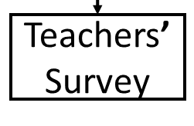
The TransMaths Project(s) Design
TransMaths-Norway: University Transition in Norway
TeLePriSM: Dispositions and Pedagogies at Secondary Mathematics UK (Year 7 to 11)

Slide 9
Analytical Framework
Instrument Development
Measures’ Construction
and Validation
(Rasch Model)
Model Building
(Multiple Regression, GLM)

Slide 10
Instrumentation
Teleprism:
Measures of teachers’ self report teaching
Students’ perception of teaching
Common items
Teachers’
Survey
Students’ perception of pre-university pedagogy
Norway
Students’ perception of university pedagogy

Slide 11
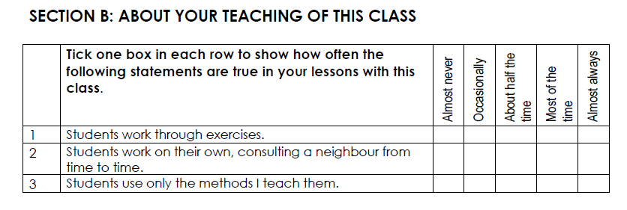
Teacher Instrument Development
28 items
  5 point Likert Scale (for frequency)
  Calibrated Swan’s original data
  Re-calibration with 110 cases from TLRP project

Slide 12
Analytical Framework
Instrument Development
Measures’ Construction
and Validation
(Rasch Model)
Model Building
(Multiple Regression, GLM)

Slide 13
Measurement Methodology
‘Theoretically’: Rasch Analysis
  Partial Credit Model
  Rating Scale Model (for the pedagogic measure)
‘In practice’ – the tools:
  FACETS, Quest and Winsteps software
Interpreting Results:
  Fit Statistics (to ensure unidimensional measures)
  Differential Item Functioning for ‘subject’ groups
  Person-Item maps for hierarchy

Slide 14
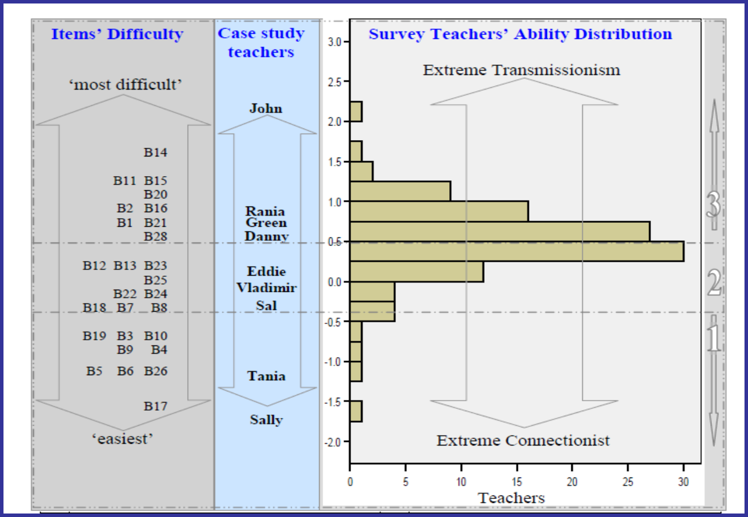
A measure of “pedagogical style”:
“Teacher centricism” Scale

Slide 15
Validation supported with Qualitative Data

Slide 16
Using the measures to answer RQ
Instrument Development
Measures’ Construction
and Validation
(Rasch Model)
Model Building
(Multiple Regression, GLM)

Slide 17
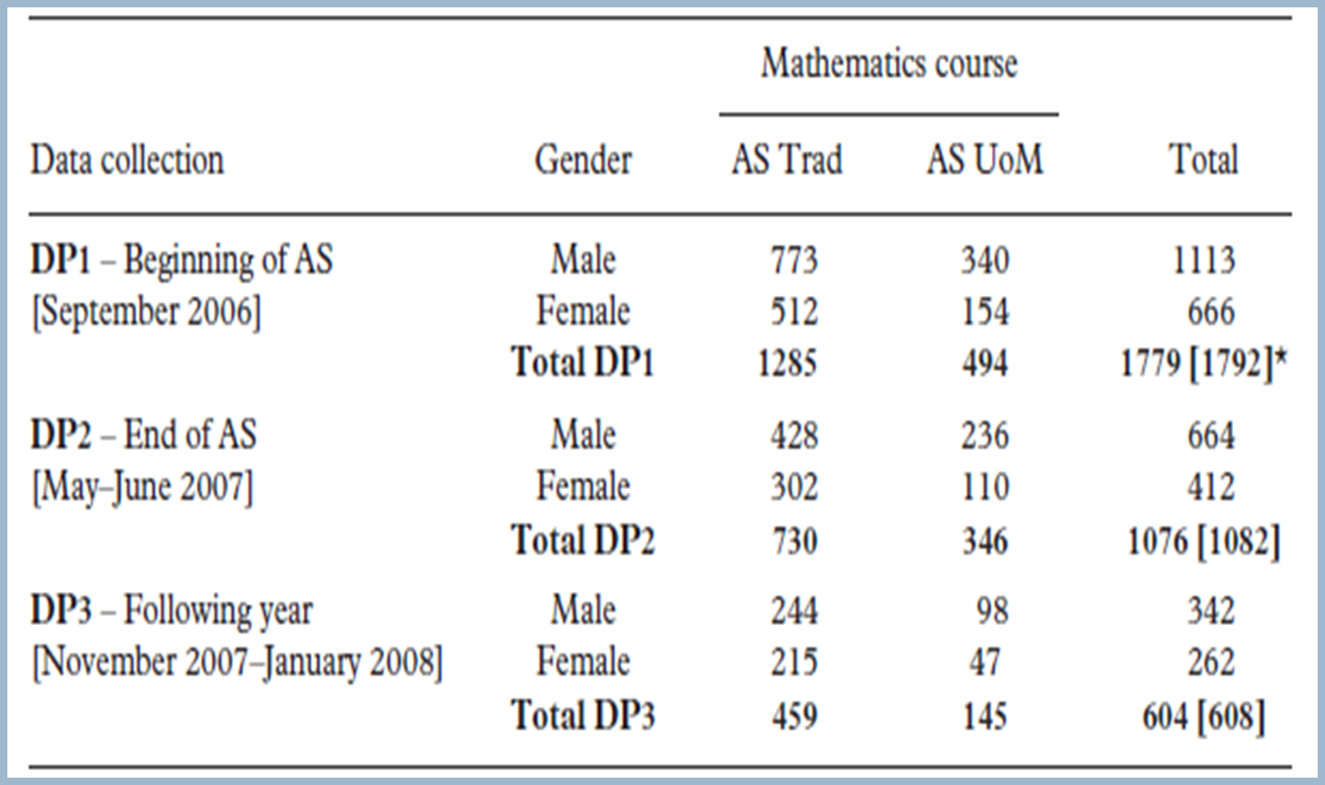
The TLRP sample

Slide 18
From Measurement to Modelling
Variables
Outcome of AS Maths (Grade, or Dropout)
Background Variables
Disposition Measures at each DP
  Disposition to go into HE (HEdisp)
  Disposition to study mathematically demanding subjects in HE (MHEdisp)
  Maths Self Efficacy
A score of ‘pedagogy’ based on teacher’s survey

Slide 19
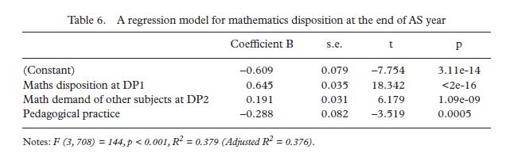
A model of HE Maths Disposition at the end of AS year
Positive effect: Math Disposition at DP1, ‘Mathematical demand of other subjects’
Negative effect: pedagogy

Slide 20
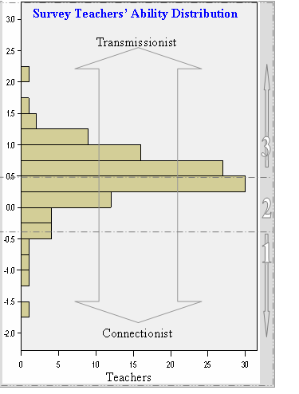
Negative effect of Pedagogy

Slide 21
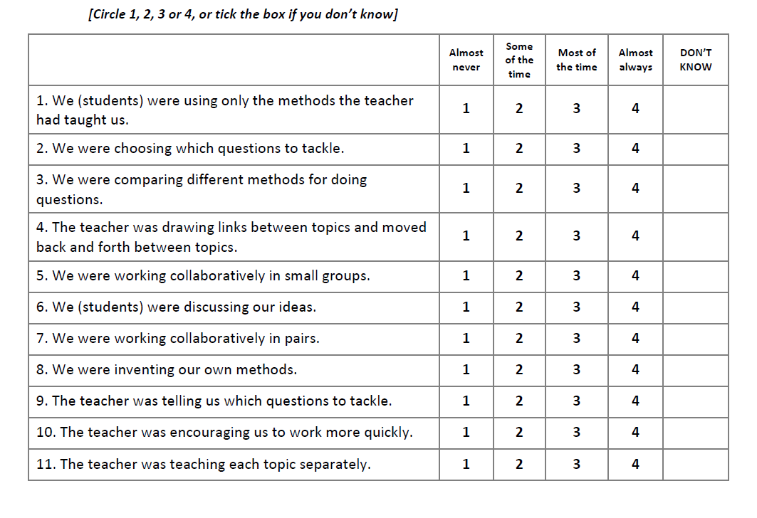
Extensions: From TLRP teacher survey to a student instrument

Slide 22
Students’ pre-uni pedagogical experience
Item Fit Statistics (UK): N=1516 students
Item 10: The teacher was encouraging us to work more quickly

Slide 23
Students’ pre-uni pedagogical experience
Item Fit Statistics (Norway): N=709

Slide 24
The issue here:
Assuming the two projects were independent: we have two valid (separate) measures of students’ perceptions of their pre-university mathematical teaching ➔ no problem
BUT: if we were to link the data of the two projects and proceed with comparative statements → more needs to be done
In Rasch (measurement) terms: we need to explore and deal with DIF

Slide 25
Differential Item Functioning (DIF)
When a variable is used with different groups of persons [or to measure the same persons on different occasions], it is essential that the identity of the variable be maintained from group to group.
Only if the item calibrations are invariant from group to group can meaningful comparisons of person measures be made.
Differential Item Functioning (DIF): a statistical way to inform this process
DIF measurement may be used to reduce this source of test invalidity and allows researchers to concentrate on the other explanations for group differences in test scores.
Groups here: Students from UK and Norway

Slide 26
UK
Norway

Slide 27
Differential Item Functioning (DIF):
Item measures of the two groups

Slide 28
Differential Item Functioning (DIF)
Harder for Norwegian students to report frequency
Easier for Norwegian students to report frequency

Slide 29
Differential Item Functioning
DIF refers to a psychometric difference in how an item functions for two groups. DIF refers to a difference in item performance between two comparable groups of examinees, that is, groups that are matched with respect to the construct being measured by the test. The comparison of matched or comparable groups is critical because it is important to distinguish between differences in item functioning from differences between groups” (Dorans & Holland, 1993, p. 35).
So the question remains: Is the instrument biased or differences are due to real differences?

Slide 30
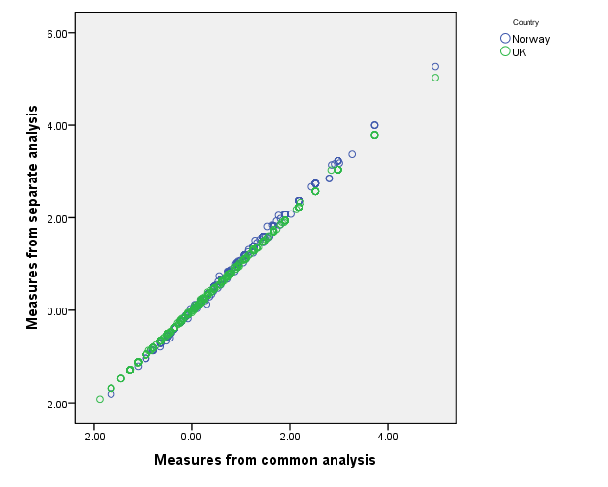
Plotting students’ measures with two different analysis

Slide 31
A comparative question
Are the students from these two countries exposed to different pre-university practices?
(according to their report)

Slide 32
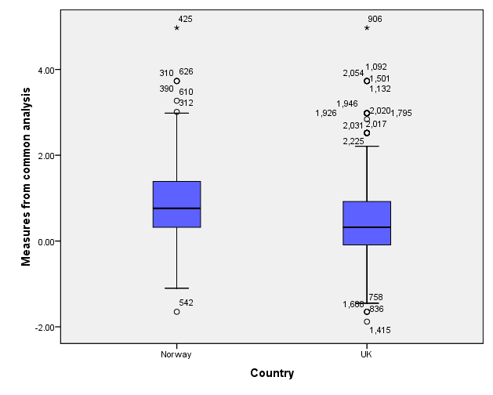
The Norwegian students reported more transmissionist practices in their pre-university maths courses
t=11.66, p<0.001

Slide 33
Another question
How is this measure of students’ perceived pre-university pedagogical experience associated with other measures of interest (e.g. dispositions, grades etc)

Slide 34
Some correlations from TransMaths UK
Pearson Correlations UK results | Pedagogy at Uni | Pre-University Pedagogy
Math Support at University (DP5) | Non significant | -0.19 (p<0.05)
Transitional Feelings (DP5) | -0.20 (p<0.001) | Non significant
Disposition to Finish Course_DP5 | -0.12 (p<0.05) | Non significant
Math confidence (DP5) | Non significant | -0.17 (p<0.001)
MHE disposition (DP5) | Non significant | -0.19 (p<0.001)

Slide 35
The Teleprism student survey and some initial findings

Slide 36
Some concluding points
We showed how it is possible to measure ‘pedagogy’ across various stages of mathematics education
(from Secondary School to University)
Cross-national comparability
Still to come:
University pedagogy cross national comparisons (Norway - UK)
Modeling of dispositions considering pedagogy (Norway)
Student’s perceptions vs their teachers’ perceptions (Teleprism)
How teachers reported pedagogies are shaped? (Teleprism)

Slide 37
References – for more information
Pampaka, M., Williams, J. & Hutcheson, G. (2011). Measuring students’ transition into University and its association with learning outcomes. British Educational Research Journal. First published on: 14 September 2011 (iFirst).
Pampaka, M., Williams, J., Hutcheson, G. D., Wake, G., Black, L., Davis, P., & Hernandez-Martinez, P. (2011). The association between mathematics pedagogy and learners’ dispositions for university study. British Educational Research Journal: First published on: 15 April 2011 (iFirst).
Hutcheson, G. D., Pampaka, M., & Williams, J. (2011). Enrolment, achievement and retention on 'traditional' and 'Use of mathematics' pre-university courses. Research in Mathematics Education, 13 (2), 147-168. D
Williams, J., Black, L., Hernandez-Martinez, P., Davis, P., Pampaka, M. & Wake, G. (2009). Repertoires of aspiration, narratives of identity, and cultural models of mathematics in practice. In M. César & K. Kumpulainen (Eds), Social Interactions in Multicultural Settings (Chapter 2, pp. 39-69). Rotterdam: Sense.
Williams, J., Black, L., Hernandez-Martinez, P., Davis, P. Pampaka, M. & Wake, G. (2009). Pedagogies for social diversity and difference. In M. David et. al. (Eds), Improving learning by Widening Participation in Higher Education (pp. 109 -123). London: Routledge.

